Slide 1
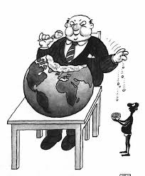
If you had unlimited power...would you use it for things that benefit you?

Slide 2
How can democracies avoid corruption?

Slide 3
Corruption
Corruption is the abuse of entrusted power for private gain
What is corruption?
Why is this a problem in a democracy?

Slide 4
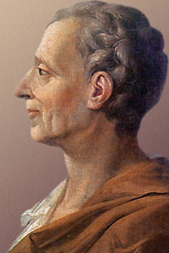
Enter...
Baron de Montesquieu!
-French Philosopher who lived in the 1700s.
-Theorised that power should be broken up in a nation
We call this the “separation of powers”
Explain who Baron de Montesquieu was in 2 sentences.

Slide 5
Executive
-President
-Prime Minister
Judiciary
-Enforces laws
-Judges etc.
Legislature
-Makes laws
-Politicians etc.

Slide 6
Task: Teacher-learner
Choose who will become an “expert” on each of the three branches of government - Executive, Legislative, Judicial
You will have 5mins to read and summarise the information in this link (also on web page) in 4-5 explained bullet points.
Executive branch will “teach” first. Teachers need to close their laptops! You will have 5 mins to teach the “learners” in your group what you know! Learners should aim to explain in their own words what they are being taught in 4-5 bullet points.
We will switch round teachers every 5mins!

Slide 7
Checks and Balances
The idea behind this is that if one branch of government becomes too powerful, the other two can act against them.
Explain why Checks and Balances are important in a democratic system
What might happen if someone was a member of the executive branch of government and one of the others?

Slide 8
How can democracies avoid corruption?

