Slide 1
Were all Nazi’s evil?
Objective- To assess how former Nazi's should be treated in light of the holocaust.
Task
What is evil?
What makes someone evil?
Can a truly evil person ever have good in
them?

Slide 2
Indoctrination- Brainwashing people to think a certain way.

Slide 3
‘A plane on take off carries 12 bombs, each weighing ten kilos. The aircraft makes for Warsaw , the centre of international Jewry. It bombs the town. On take off with all bombs on board and a fuel tank containing 1500 kilos of fuel the aircraft weighed 8 tonnes. When it returned from the crusade, there were still 230 tonnes of fuel left. What is the weight of the aircraft when empty?’
Sample question from a Nazi Maths text book
Tasks
1. How did the Nazi's try to indoctrinate children?
2. Why did the Nazi's try to indoctrinate children?
3. If an indoctrinated child is taught that murder is correct, is he/she commiting a crime when they do murder someone? Explain fully.

Slide 4
The Allied forces (led mainly by Britain, The United
States and Russia) forced the Germany army into
treat by 1944.
By 1945 they were within months of reaching Berlin.
They liberated prisoners of concentration camps as
they went.
They were horrifed by what they saw.

Slide 5
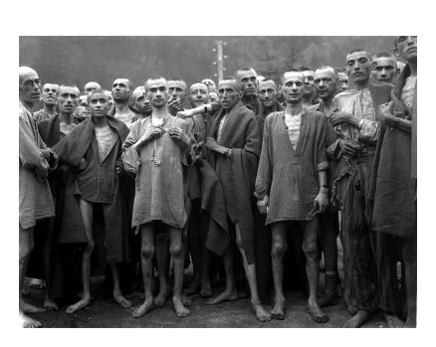
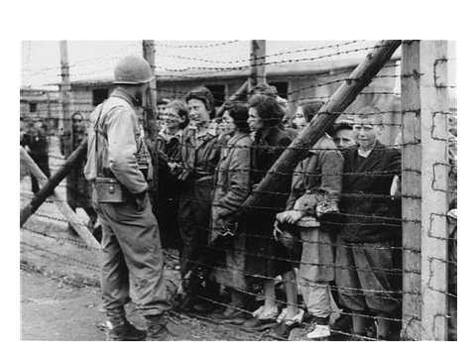

Slide 7
Vultures by Chinua Achebe
1. What is the message of the poem?
2. What do you think of the poem? Why?
3. Do you agree that joy should be taken from the idea that there can be good within evil? Why?

Slide 8
How should Nazi's have been treated after the War?
Explain your answer in two paragraphs (one for, one against and add a conclusion.)
Extension- Would you forgive a reformed Nazi if you had been in a camp? Write a letter to a former Nazi explaining your reasoning.

